Slide 1
Multiplication Algorithm

Slide 2
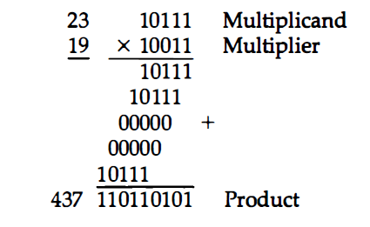
Multiplication of two fixed-point binary numbers in signed-magnitude representation is done by a process of successive shift and add operations.
Look at successive bits of the multiplier, least significant bit first.
If multiplier bit is 1, the multiplicand is copied down. Otherwise, zeros are copied down.
Number copied in successive lines are shifted one position to the left from the previous number.
Add numbers, Sum forms the product.
The sign of the product is determined from the signs of the multiplicand and multiplier. If they are alike, the sign of the product is positive. If they are unlike, the sign of the product is negative.

Slide 3
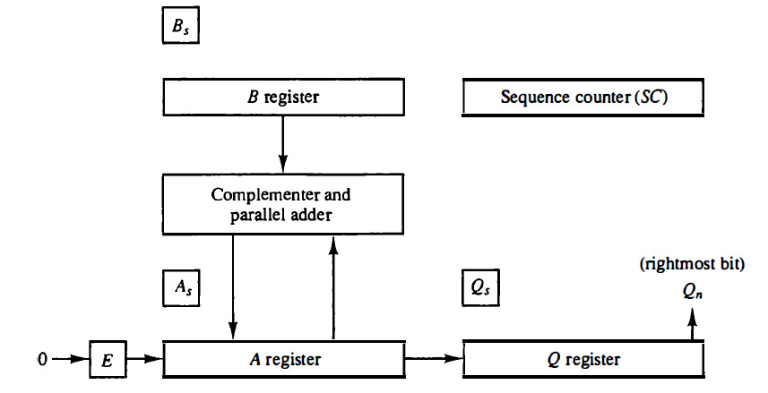
Hardware Implementation

Slide 4
Multiplicand is stored in Register B and multiplier in Q.
Sequence Counter SC is initially set to a number equal to number of bits in the multiplier.
Counter is decremented by 1 after forming each partial product.
Sum of A and B forms the partial product which is transferred to the EA register.
Both partial product and multiplier are shifted to the right. (shr EAQ)
LSB of A is shifted into the MSB of Q, bit from E is shifted into the MSB of A and 0 is shifted into E.
In this manner right most bit of the multiplier will be inspected next.

Slide 5
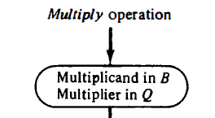
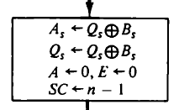
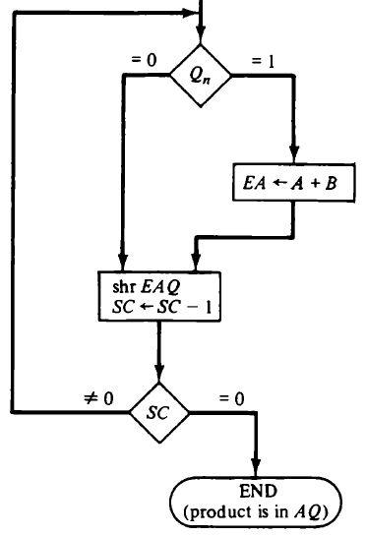

Slide 6
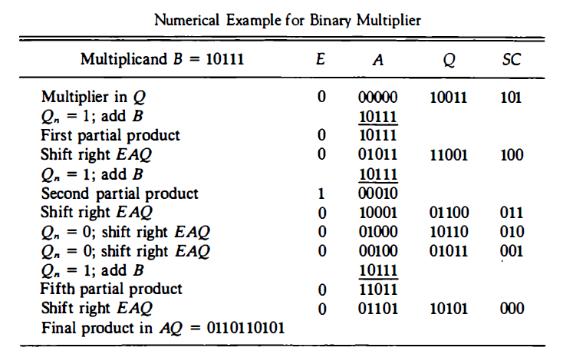

Slide 7
Booth Multiplication Algorithm
It gives a procedure for multiplying binary integers in signed 2’s complement form.
Algorithm was invented by Andrew Donald Booth in 1950.
Strings of 0’s in multiplier -> No addition, just shifting
Strings of 1’s in multiplier from bit weight 2^{k} to weight 2^{m} can be treated as 2^{k+1} - 2^{m}
001110(+14)
(k=3, m=1) -> 2^{k+1} - 2^{m} -> 2⁴ – 2¹ -> 16 - 2 = 14
M x 14 -> M x 2⁴ - M x 2¹

Slide 8
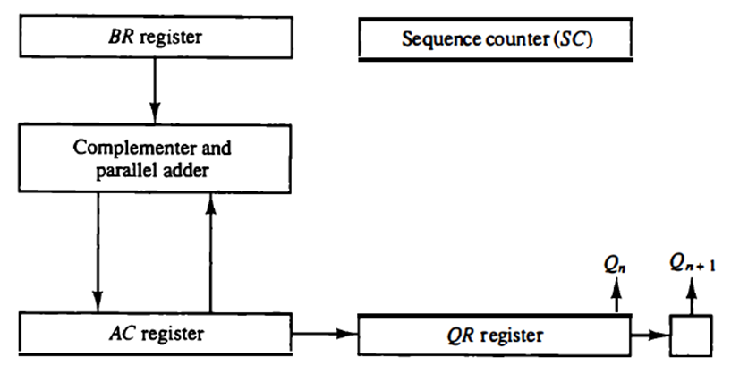
Hardware for Booth Algorithm

Slide 9
Hardware Implementation
Sign bits are not separated from the rest of the registers.
Q_{n} designates least significant bit of the multiplier in register QR.
An extra flip-flop Q_{n+1} is appended to QR to facilitate a double bit inspection of the multiplier.

Slide 10


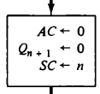
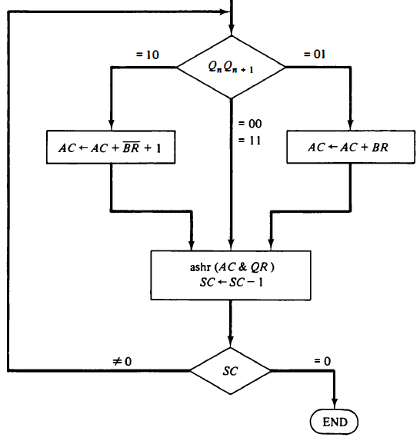
Multiplicand is subtracted from partial product when first least significant 1 in a string of 1’s in multiplier is encountered.
Multiplicand is added to partial product upon encountering the first 0 (Provided that there was previous 1) in a string of 0’s in the multiplier.
Partial product does not change when the multiplier bit is identical to the previous multiplier bit.

Slide 11
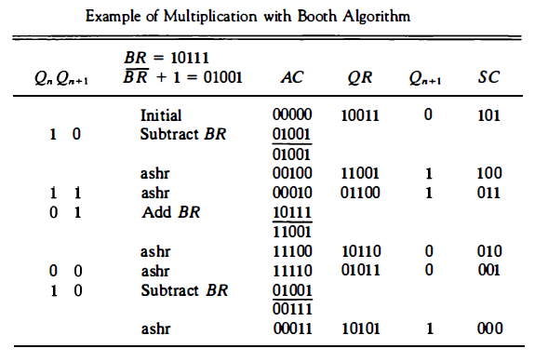
(-9) x (-13) = +117

